Slide 1

Tech Nova
Human Resources Graduation Project.
Konecta’s Internship Program
PAGE 01

Slide 2



Tech Nova
Who is tech nova?
We are a company specializing in providing integrated IT solutions and services.
We work to enable companies and organizations to achieve digital transformation and improve their efficiency by providing high-quality technical services in various fields.
PAGE 02

Slide 3











Tech Nova
COMPANY STRUCTURE
CEO
CEO
Ahmad Elharany
CHIEF TECHNOLOGY OFFICER
(CTO)
CHIEF PEOPLE OFFICER (CPO)
CHIEF BUSINESS OFFICER
(CBO)
CHIEF FINANCIAL OFFICER (CFO)
RANA MAGDY
RAWAN AMEN
ABANOB ADEEP
SHADY ESSAM
IT OPERATIONS MANAGER
LEAD SOFTWARE ENGINEER
HR MANAGER
FINANCE MANAGER
BUSINESS SOLUTIONS MANAGER
DATA TEAM LEAD
WATEN AHMED
MOHAMED HASSAN
FARAH ASHRAF
NOUR YASEER
BASMALLA HAZEM
SARA OSMAN
IT SUPPORT ENGINEER
FULL STACK DEVELOPER
RECRUITMENT SPECIALIS
ACCOUNTANT
PROJECT MANAGER
DATA ANALYST
mariam khalid
malak mohamed
alaa mahmoud
mohamed nagy
omar gareb
mohamed atef
HELPDESK SPECIALIST
FRONTEND DEVELOPER
HR GENERALIST
FINANCIAL ANALYST
CRM SPECIALIST
DATA SCIENTIST
veronica wageh
yara adel
alaa asem
asmaa hassan
kareem amr
mostafa ashraf
NETWORK ADMINISTRATOR
QA ENGINEER
TRAINING & DEVELOPMENT COORDINATOR
PAYROLL SPECIALIST
BUSINESS ANALYST
BI DEVELOPER
samar mohamed
mohamed khalid
nada amr
eslam ramadan
shahd hatem
mostafa hussen
DATABASE ADMINISTRATOR (DBA)
DEVOPS ENGINEER
PERFORMANCE & COMPENSATION ANALYST
BUDGETING & REPORTING OFFICER
CUSTOMER SUCCESS OFFICER
DATA MODELER / ERD DESIGNER
ahmad sayed
reham mohamed
vapian
malaka wageh
mahmoud sayed
shazaa ahmed

Slide 4

Tech Nova
tech nova has a big problem which is....
high employee turnover
PAGE 04

Slide 5










Tech Nova
we noticed that the high job turnover rate was causing us to lose resources, time and effort due to doing many steps including the job description, the job ad, the competency based interview, job offer, and the pip.
job descriptioN
JOB AD
THE COMPETENCY BASED INTERVIEW
JOB OFFER
PIP
PAGE 05

Slide 6
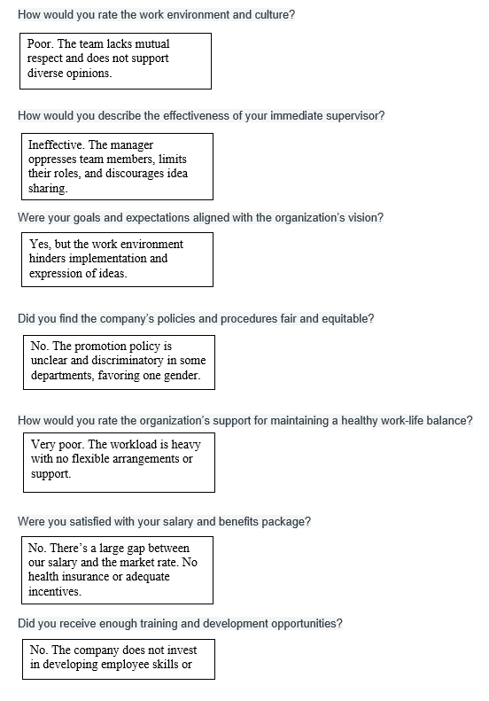
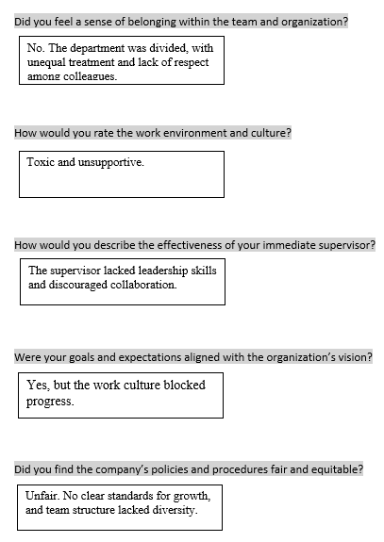


Tech Nova
To solve the problem, we worked on exit interviews and an engagement survey.
scan me
PAGE 06

Slide 7
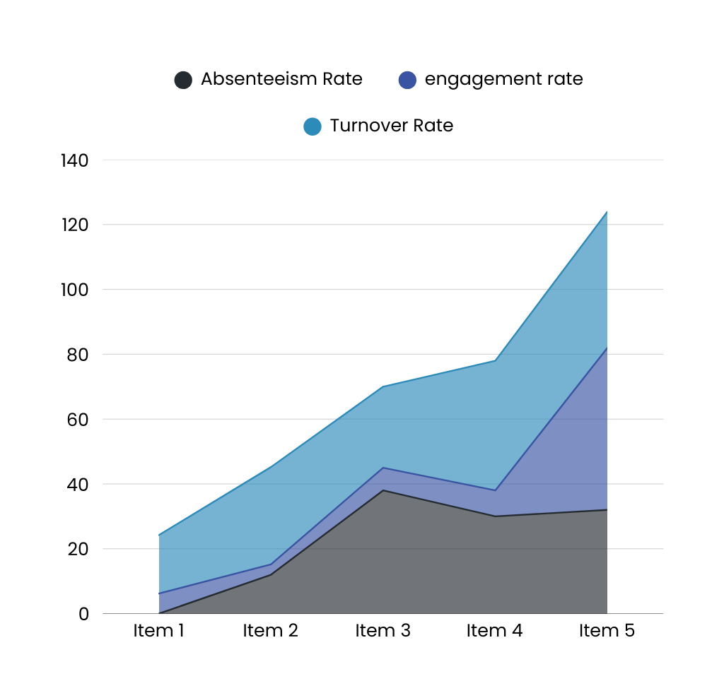


Tech Nova
HR METRICS
we did an HR matrix and got an The Absenteeism Rate and the results were as follows: 2% ,employee engagement rate and the results were as follows: 5.94 and Turnover Rate and the results were as follows: 32%
PAGE 07

Slide 8

Tech Nova
After analyzing the situation, we found that the root of the problem was:
Manager's behavior not as expected.
Lack of professional development.
Lack of promotions.
Salary not commensurate with job.
Salary below market standards.
Lack of incentives.
Sense of alienation.
Not feeling part of the organization.
No work-life balance concept.
Racism in various forms across departments.
PAGE 09
PAGE 08

Slide 9
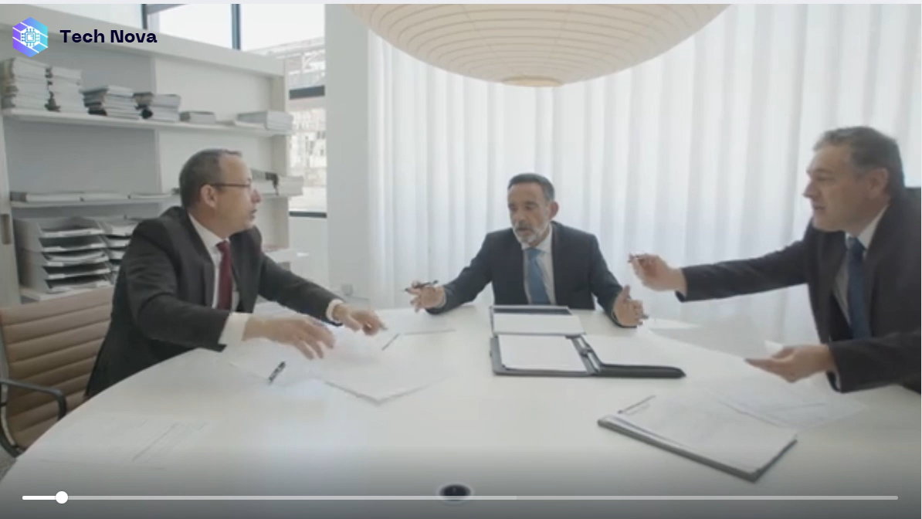

Slide 10




Tech Nova
OUR TEAM SOLUTION
PAGE 10

Slide 11









Tech Nova
OUR STEPS TO SOLVE THE PROBLEM
engagement strategy
We have been working to increase our employee satisfaction and engagement.
HR Analytics
We analyzed all the problems one by one to find out the root cause. We were not only losing our employees but also our company.
training plan
We decided to invest in our employees, so we started working on their needs, training and development.
KPI
We worked on the KPIs for each employee and determined the appropriate system for promotion.
PAGE 11

Slide 12






Tech Nova
IN ADDITION TO WORKING ON OUR OWN POLICIES
We worked on the idea of ​​promotions.
We worked on taking the work life balance into consideration and made the work system a hybrid one.
We worked on an incentive system for employees, taking into account the KPIs of each employee.
PAGE 12

Slide 13
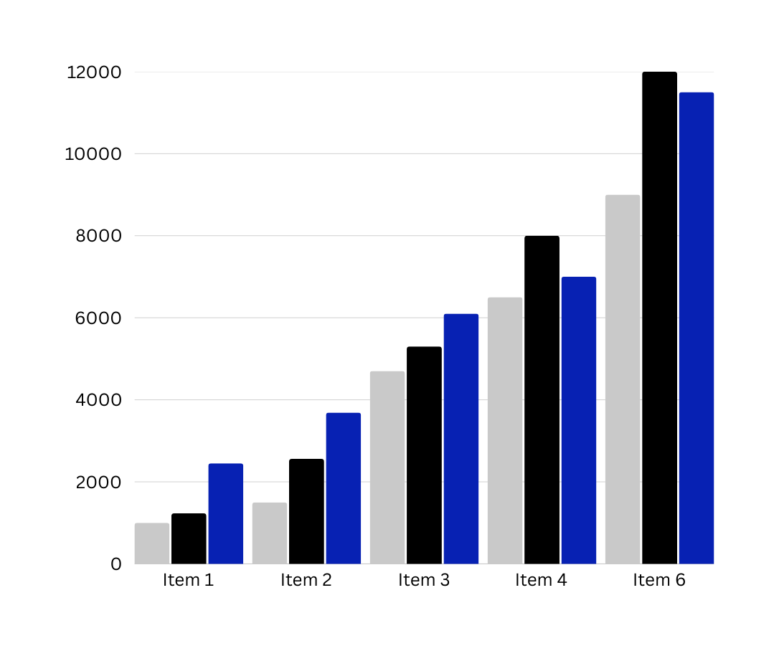

Tech Nova
RESULTS
Employee satisfaction and lower turnover rate after new business strategy every month
PAGE 13

Slide 14




Tech Nova
Thank You.
CONTACT US :
+20 114 3517 550
www.Tech Nova.com
Egypt. Cairo

Slide 15

BUSINESS STRATEGY
SUCCESSFUL

